Slide 1
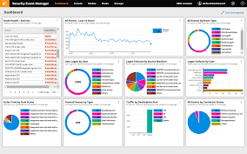
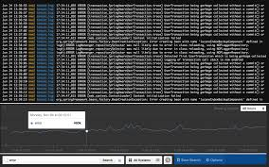
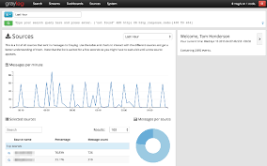
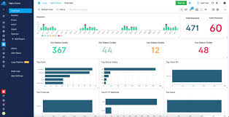
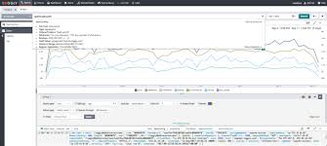
Log File Analysis & Reporting System
SHANTHINI R

Slide 2
Tabel of context
1
introduction
2
PROBLEM STATEMENT
3
System Architecture Diagram
4
Database Schema
5
Core Features
6
7
Reporting & Analytics
TESTING & VALIDATION

Slide 3
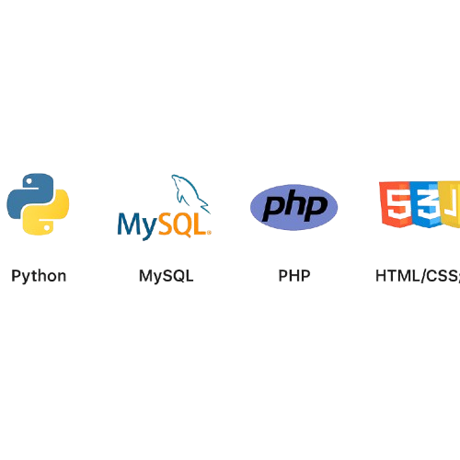
Introduction
A CLI + Web Dashboard tool to process and analyze Apache web server logs. It reads large log files, extracts structured information using regular expressions, and stores the data into a MySQL database.
Purpose: To automate the extraction and reporting of insights from semi-structured log data—such as traffic trends, top visitors, and error distributions—simulating a real-world data engineering workflow.
Tech Stack: Python, MySQL, PHP, HTML/CSS/JS

Slide 4
Problem Statement
Background:
Goal:
Web servers generate extensive log files that record every client request. These logs are critical for analyzing traffic, identifying errors, and ensuring system security.
To build a modular system that simulates a real-world data pipeline, enabling log ingestion, storage, and analysis—while improving maintainability and scalability.
The Challenge:
Core Problem:
Raw Apache log files are unstructured and difficult to interpret
Manually analyzing logs is time-consuming and error-prone
Existing tools may lack customization
Businesses need quick, insightful reports to make data-driven decisions
✔Efficiently parse Apache log files ✔Store structured data in a database ✔Generate actionable insights through both CLI and visual dashboards

Slide 5
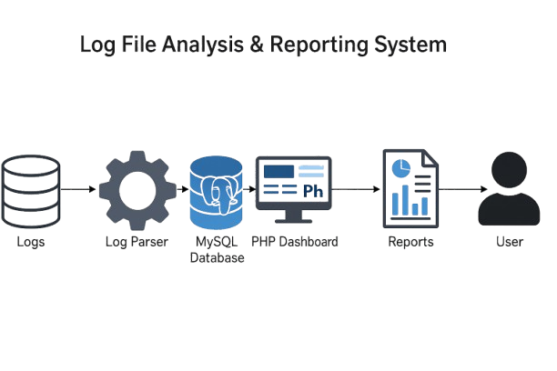
System Architecture Diagram
The system starts with raw Apache log files as input. A Python CLI parser extracts fields using regex, normalizes them, and inserts structured data into a MySQL database.
The database holds normalized tables like <log_entries> and <user_agents>.
Reports are generated via a terminal cli or an optional web dashboard built with php and chart.js for visual insights.

Slide 6
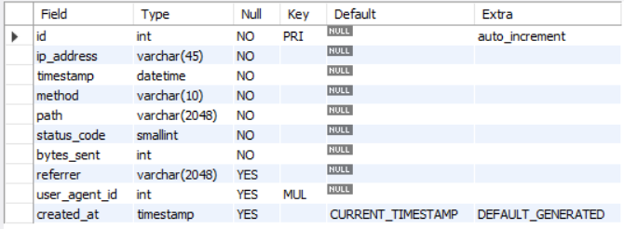
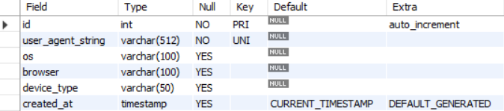
Database Schema
log_entries
The schema consists of two main tables:
log_entries: Stores detailed log data for each request, including IP, timestamp, method, URL path, status code, bytes sent, referrer, and a foreign key to the user agent.
user_agents: Contains unique user agent strings with parsed information such as OS, browser, and device type to normalize repeated data.
This design reduces redundancy and improves query performance with appropriate indexing.
Enables efficient storage, retrieval, and analytical querying of large volumes of log data.
user_agents

Slide 7


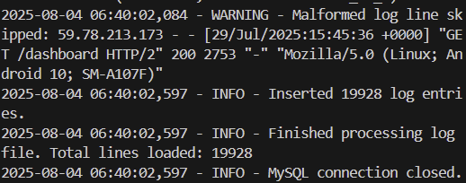
Core Features
Log Parsing: Efficiently reads large Apache logs using regex to extract key fields like IP, timestamp, method, status, and user agent.
Data Normalization: Converts raw data into structured format and separates repeated fields (e.g., user agents).
Batch Loading: Uses executemany for fast, large-scale data inserts into MySQL.
Idempotent Processing: Avoids duplicate entries during repeated log imports.
CLI Interface: Simple commands to parse logs, view reports, and optionally monitor logs.
Advanced Reports: Analyzes top IPs, status codes, traffic patterns, OS usage, and errors.
Error Handling: Skips bad lines, logs issues, and ensures reliable processing.

Slide 8
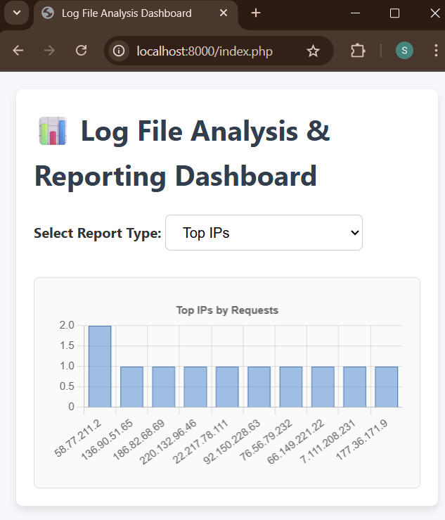
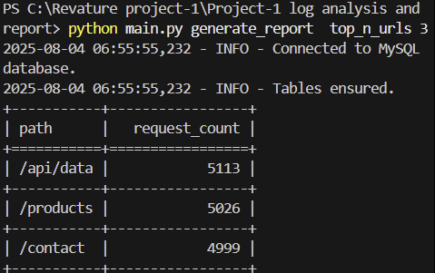
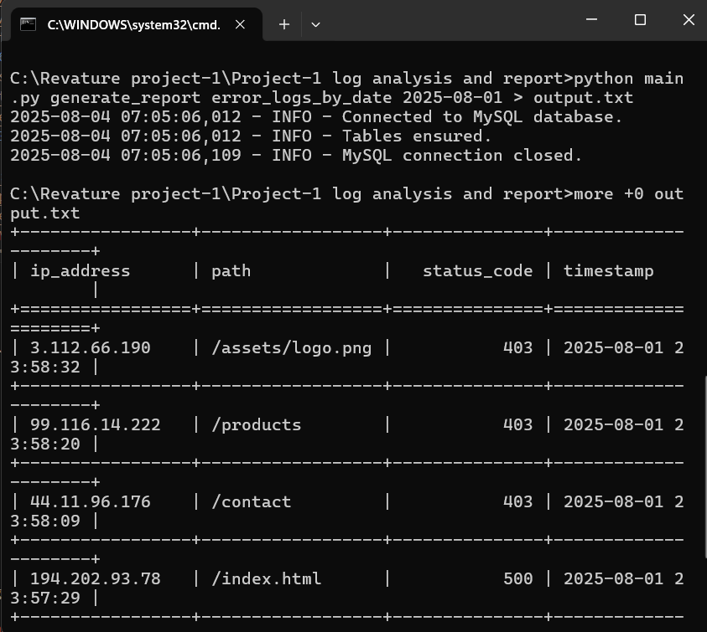
Reporting & Analytics
CLI Reports
Web Dashboard
Filtering & Insights
Generate reports like top IPs, status code summary, traffic by hour, and error logs via terminal.
Interactive charts using Chart.js for traffic trends, error rates, and user agent analysis.
Filter data by date, status, or browser; gain insights for server optimization and issue tracking.

Slide 9
🧪 TESTING & VALIDATION
Functional Testing: Verified core features such as log parsing, database insertion, report generation, and dashboard visualizations worked as expected for various log formats.
Data Accuracy Checks: Cross-validated parsed data in MySQL against original Apache log files to ensure correctness and integrity.
Performance Testing: Handled large log files (10,000+ entries) using batch processing, ensuring fast and reliable ingestion without crashes.
Error Handling Validation: Intentionally used malformed log lines to confirm the parser skips them gracefully and logs appropriate warnings.
UI Testing: Ensured the dashboard renders charts accurately and updates dynamically based on selected filters.

Slide 10
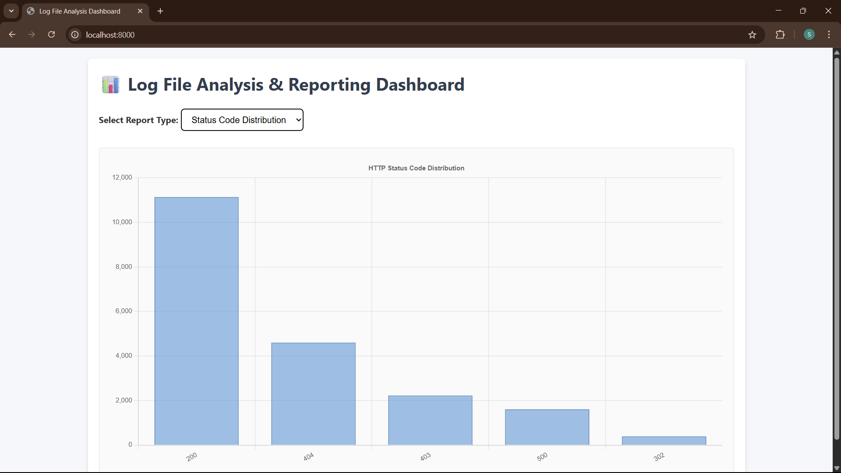
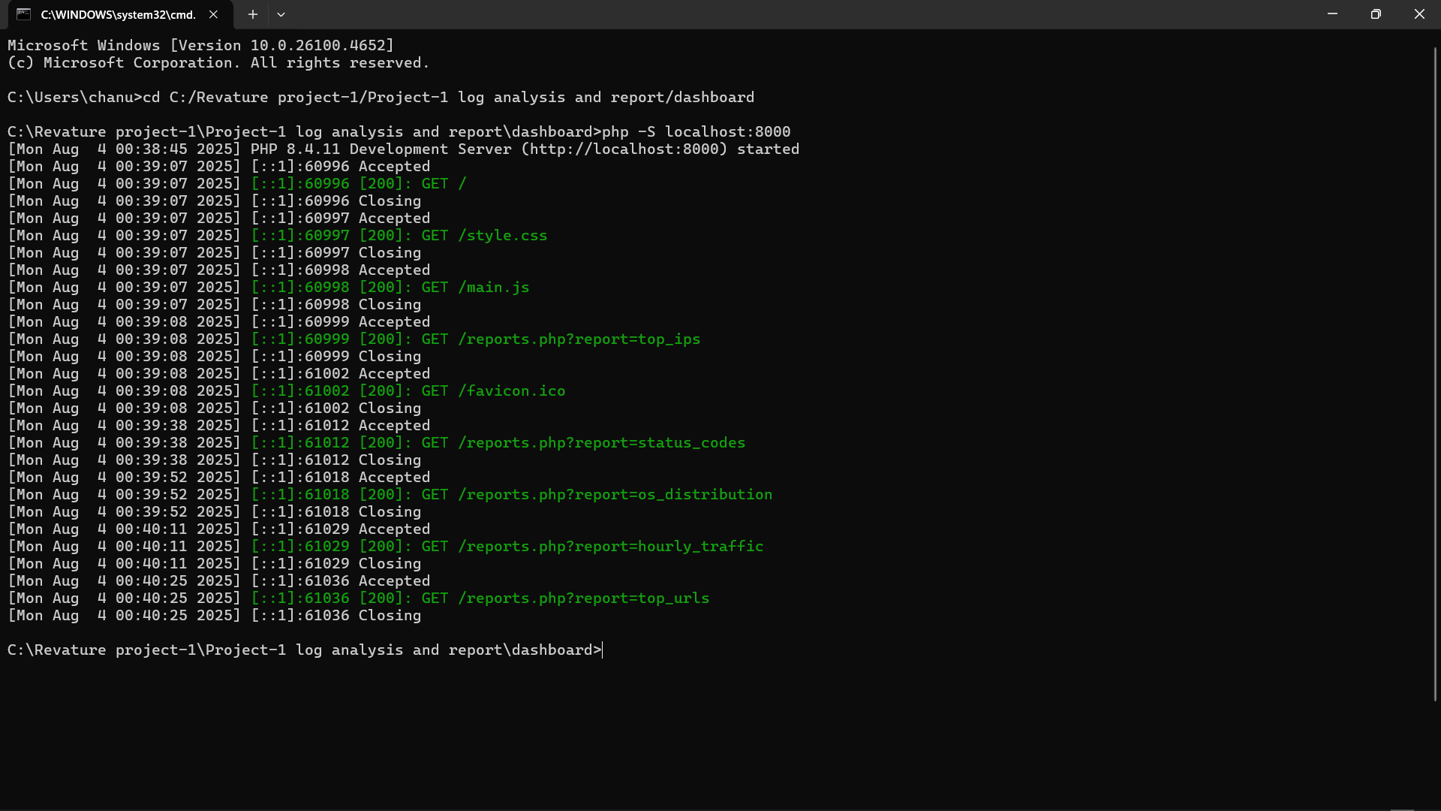
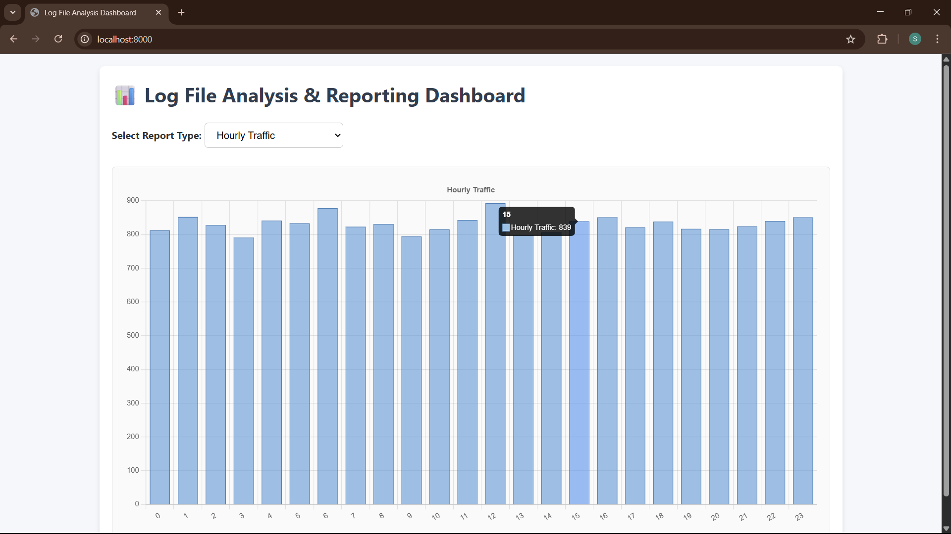
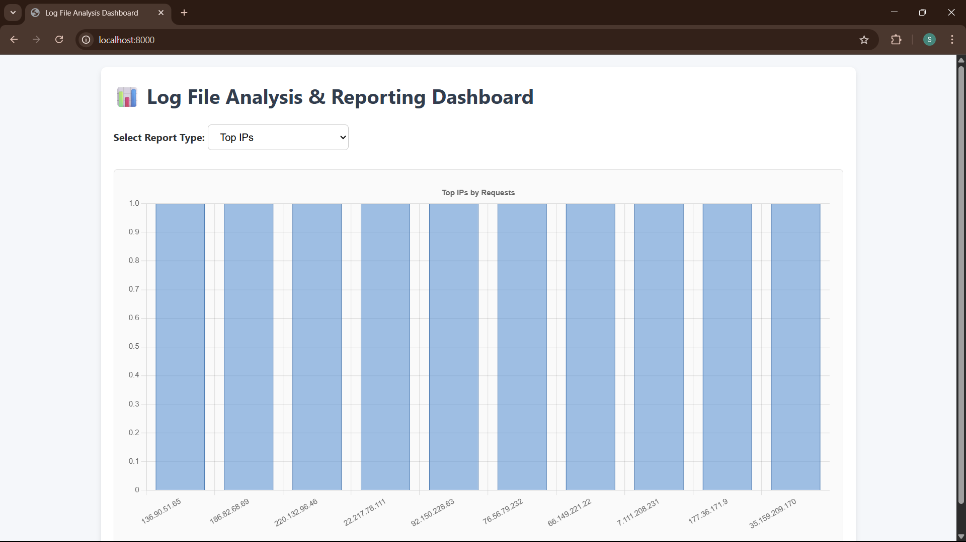
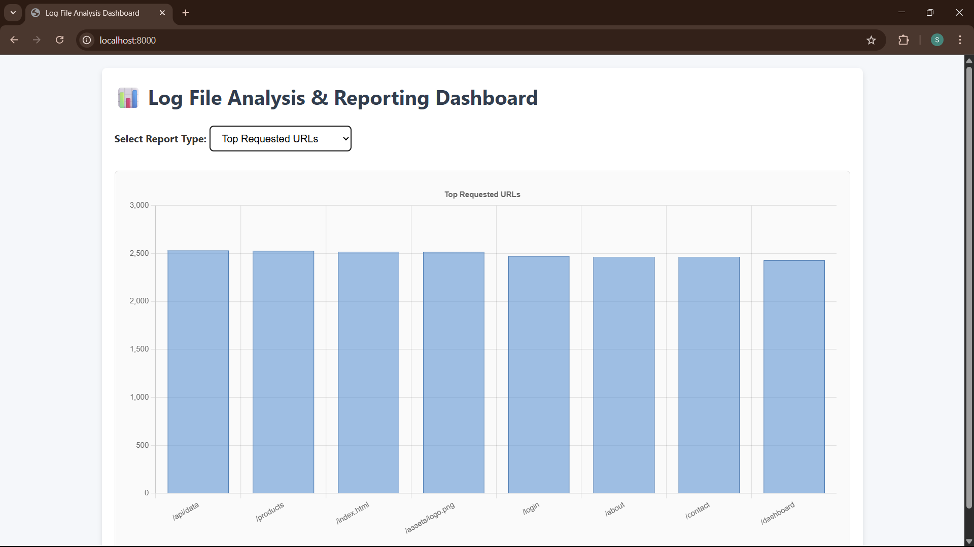
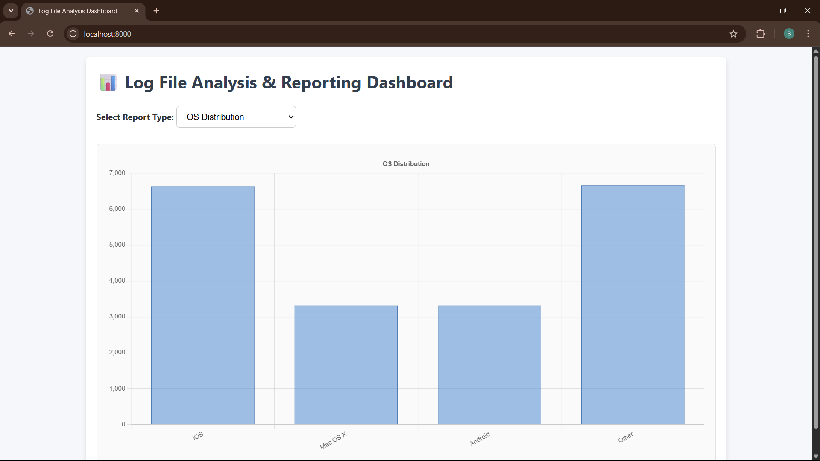
Output

Slide 11
Conclusion
Future Enhancements
The Log File Analysis & Reporting System offers a solution for real-time log monitoring and reporting. It combines efficient backend parsing with a user-friendly CLI and web dashboard, enabling insights into server behavior, user traffic, and error trends. This modular design ensures maintainability, scalability, and practical usability in real-world deployments.
List possible improvements or additional features.
Example Content:
Add support for Nginx or custom log formats
Live log streaming with WebSockets
Role-based authentication for the dashboard
Export reports to PDF or CSV

Slide 12
Thank you

